Slide 1
Bureau for Rapid Annotation Tool: Collaboration Can Do More Over Variety-oriented Annotating
Zheng Wang
wangz@istic.ac.cn
Instute of Scientific and Technical Information of China
Haidian District, Beijing, P.R. China
Shuo Xu
xushuo@bjut.edu.cn
Beijing University of Technology
Chaoyang District, Beijing, P. R. China

Slide 2
1 and 3.33BTC
Manual annotating is crucial for text mining, information extraction and the development of knowledge graph construction.
For example, a common scenario like ”Depending on the model, a Tesla costs somewhere between 1 and 3.33 BTC” (Benson,2021), whether ”1 and 3.33 BTC” can be marked as ”Price”, this depends on a consensus acknowledging Bitcoin as actual ”Money”.
What properties has this consensus?
Previous workbenches ... allows users to do some teamwork and identify what similar semantic natures their annotations performed ...
But they still can’t solve the “1 and 3.33 BTC” problem.
Notes:
As for Kant: The one refers to the objects of the pure understanding, and is intended to show and explain the objective value of its concepts a priori. It is, therefore, of essential importance for my purposes.

Slide 3
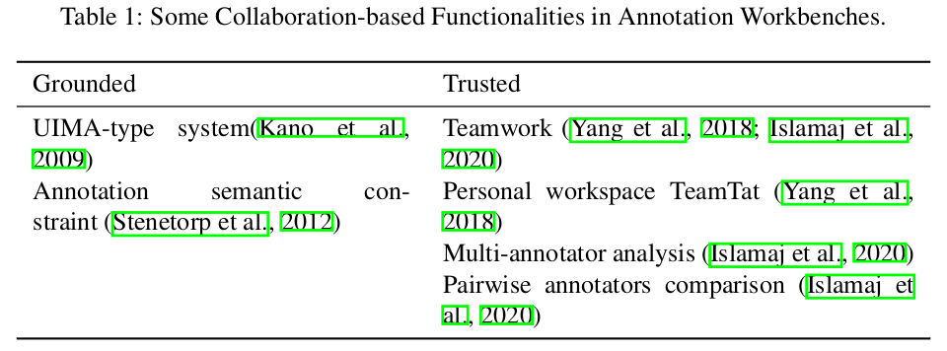
Collaboration
Although it’s still miserable that how annotating collaboration begins with the private senses, proceeds then to the semantic understanding, and ends with acknowledged schema, two types of annotating collaboration can be distinguished, and we refer them as grounded collaboration and trusted collaboration.
Notes:
All our knowledge begins with the senses, proceeds then to the understanding, and ends with reason.

Slide 4
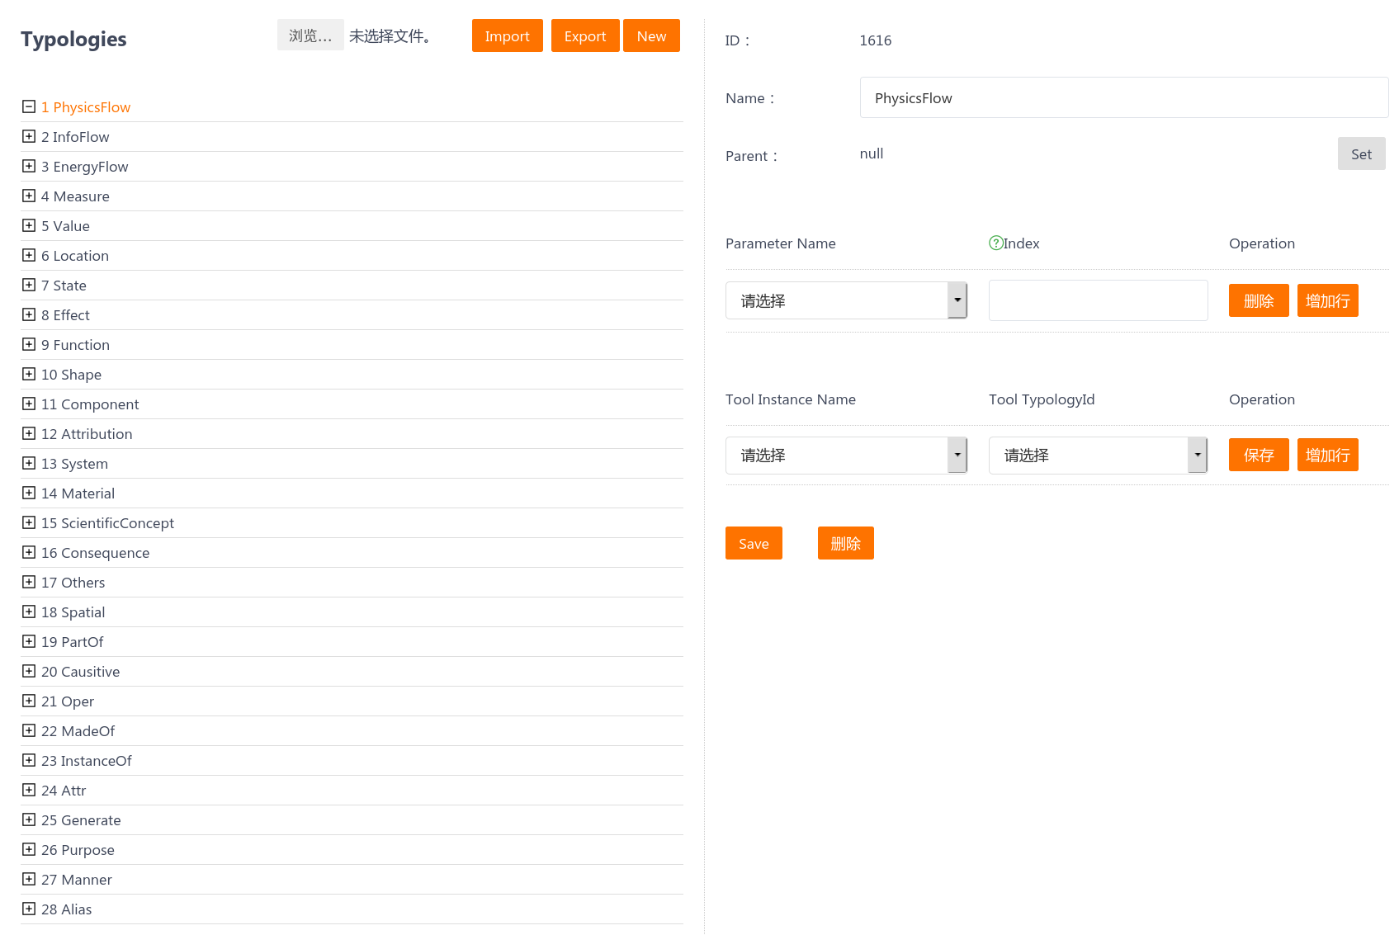
Enhanced Semantic Constraint System
Two entities ”Tesla” and ”1 and 3.33 BTC” should separately take exact entity types as ”Thing” and ”Price”.
By giving certain semantic meaning to name, parent entity type or relationship, and parameters (for relationship), it’s efﬁciently to express managers’ understanding to annotators.
Managers are able to customize annotation schema at any time during the annotation project via a panel

Slide 5
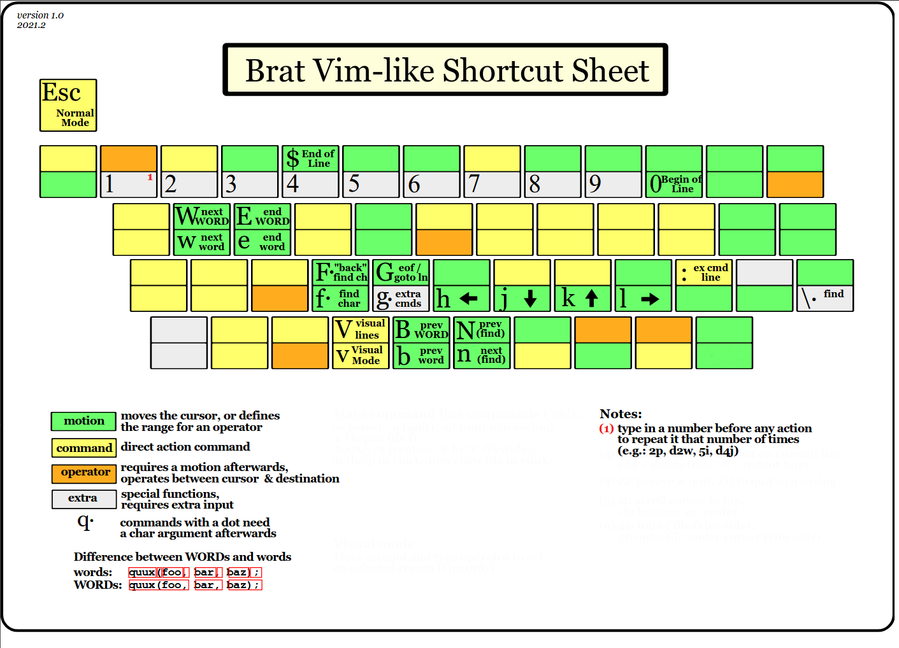
Vim-like Shortcut Key(1)
With tuned muscle memory, annotators are assisted understanding managers’ schema and forming instinct, which may help aware potential semantic conﬂicts.

Slide 6
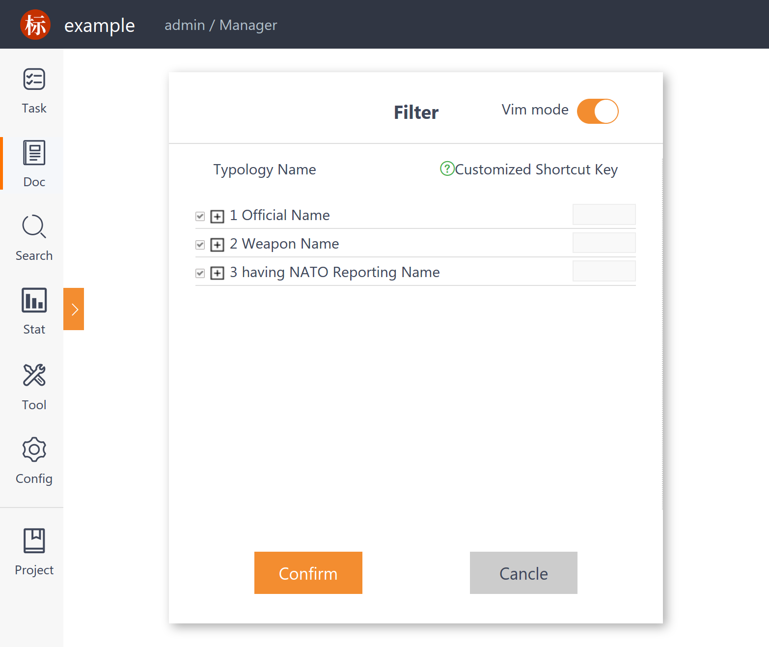
Conﬁgurable Annotation Filter
This individual conﬁgurable ﬁlter only allow annotations completely passing it to display in current workspace, so confused operation and schema misunderstanding may be reduces. Or in other saying, annotators might be easier to concentrate its own schema understanding.

Slide 7
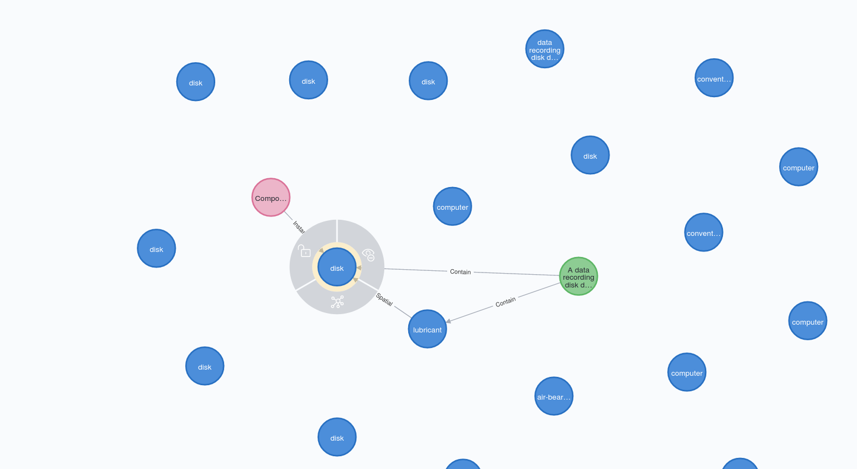
Graph-visualizing Browser
Embedded query engine can load and index all texts, annotations and their types, that these entities, entity types, relationships and documents are represented as nodes, and relations as edges in graph-visualizing browser.
Managers and annotators are supposed to gather supporting semantic evidence and inspect potential disagreements via annotation querying, nodes/edges selecting and visible domain toggling.

Slide 8
Conclusion
Nowadays, over 500,000 annotating has been made on Brat. Many projects utilized Brat to inspect potential conﬂicts over variety-oriented annotations.
Brat service is now available to community (just register and login on https://168.160.19.110/brat/projectManagement/login.html)

Slide 9
Contract Us
Zheng Wang
wangz@istic.ac.cn
Instute of Scientific and Technical Information of China
Haidian District, Beijing, P.R. China
Shuo Xu
xushuo@bjut.edu.cn
Beijing University of Technology
Chaoyang District, Beijing, P. R. China

